Slide 1


The Truth About
Galatians 4:8-11

Slide 2

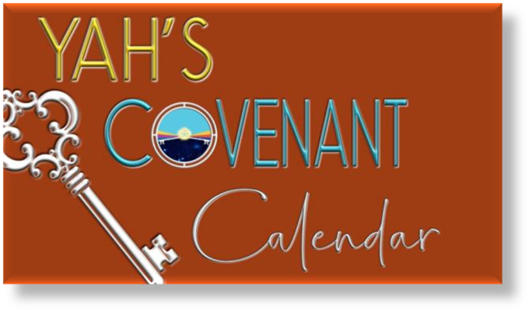
A
teaching
Addressing Yahuah’s Feasts

Slide 3

Just for clarification: In my presentations
I am using YHVH (Yahuwah) instead of LORD, which is a title and not a name. I also use Yahusha instead of Jesus, which is not a translation but a transliteration and really
has no meaning, neither in Hebrew nor in English! YHVH (Yahuwah) and Yahusha are the actual original names and the
true nature and character of them.

Slide 4

This passage in Galatians 4:8-11 is very controversial within the nominal Christian denominations of whether or not Torah’s Feasts & Festivals are still valid today.
Let’s see, if we can find out, what Galatians is really talking about! First we must read everything
in context and let the Bible
interpret itself.

Slide 5
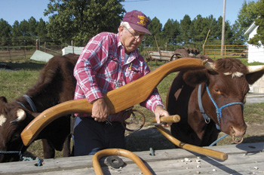
Here is what Paul states
in Galatians 5:1 …
“Stand fast therefore in the liberty wherewith Messiah hath made us free, and be not entangled again with the yoke of bondage.”
Notes:
…………….

Slide 6
Insisting that Paul taught that the
Old Testament Law was “done away,”
Christians conclude they no longer need
to keep the Torah (or Law) of Yahuwah, which according to their idea means that they are exempt from keeping the weekly
7th day Sabbath AND YHVH’s yearly appointed festivals since the cross.

Slide 7

There was an old hymn, which sums up the popular but emotional belief of Christians and their attitude towards Yahuwah’s Law, especially the Torah, which said:
“Free From The Law,
O Happy Condition!”

Slide 8
However, Yahusha, our Saviour gave a different message to David in Psalm 40:8!
“I delight to do thy will,
O my Elohim:
yea, thy Torah [is]
within my heart.” KJV
8

Slide 9

Let’s turn to Galatians 4:8-11
8. “Howbeit then, when ye knew not God (Elohim), ye did service unto them which by nature
are no gods.
9. But now, after that ye have known God (Elohim), or rather are known of God (Elohim), how turn ye again to the weak and beggarly elements, whereunto ye desire again
to be in bondage?

Slide 10
Continuing Galatians 4:8-11
10. Ye observe days, and months,
and times, and years.
11. I am afraid of you, lest I have
bestowed upon you labor
in vain.” KJV
The common, traditional explanation of Galatians 4:8-11
is that Paul is reprimanding the Galatians for returning to
Old Testament observances that were a form of “bondage.”

Slide 11
Is that traditional
explanation
correct?
Does this popular tradition
correspond to Torah truth?
Is that really what Paul was saying?

Slide 12

It is extremely important to pass on the warning Peter gave in reference to some of Paul’s writings and not to take his advice lightly!
2 Peter 3:16 (KJV) states:

Slide 13

“As also in all his [Paul’s] epistles,
speaking in them of these things;
in which are some things
hard to be understood ...

Slide 14
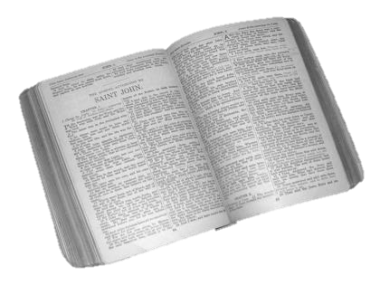
In Galatians 4:10 Paul states:
“Ye observe days,
and months, and times, and years.”
People claim that the “days” referred to here are YHVH’s yearly “feast days.” They further hold the idea that this Scripture gives permission to avoid observing these holy daysas they are no longer valid for His followers today.

Slide 15
At first glance does it literally say …
Pentecost
Passover
Days of Unleavened Bread
Day of Atonement or
Feast of Tabernacles?

Slide 16
Of course NOT!
Is it really expected that one should believe that Yahuwah’s Holy Feast days have been abolished
without any Biblical proof!
That would be a dangerous assumption!

Slide 17
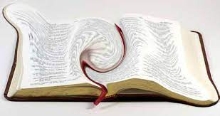
That could put one in the category Peter spoke of - twisting Scripture unto
our own destruction.
First …
we need to ask some questions and then search for the answers.

Slide 18
Is Paul referring to YHVH’s yearly appointed festivals in Galatians 4:8-11?
What right does anyone have to make that kind of an assumption?
Should we ever read anything more
into a Bible verse
then what it actually says?

Slide 19
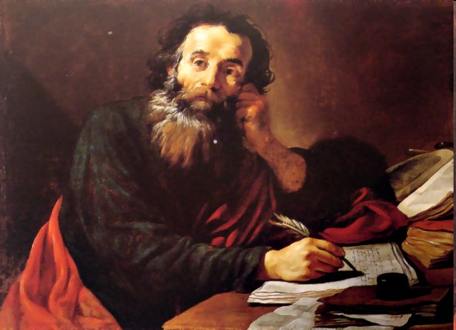
Who were the Galatians that Paul wrote to? Where did they live, and what was their background?

Slide 20
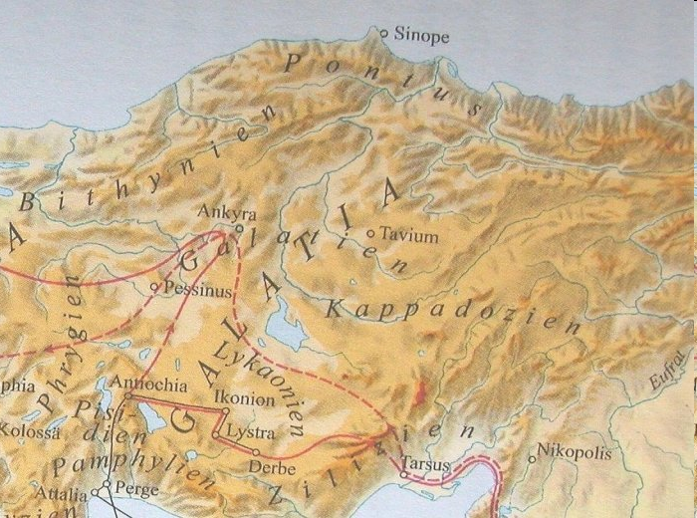
Galatia was not a city but a province in Asia Minor.
The church membership undoubtedly was composed
of mainly Gentiles, and the males were physically uncircumcised. (See Galatians 5:2; 6:12-13.)
20

Slide 21
They were Gentile converts that had come from a background of pagan practices.
As mentioned, Galatia was a region in
Asia Minor where the churches of
Lystra, Iconium, Antioch, Derby
and others were located.
Acts 14:8-18 talks about their background.

Slide 22
These people had a history of
worshipping pagan deities.
The Galatians were Gentiles.
They used to serve idols instead of the true Elohim as Galatians 4, verse 8 says:
“When ye knew not YHVH (God),
ye did service unto them
which by nature are no gods.”
In other words: they served the
“no gods” – many of them!

Slide 23
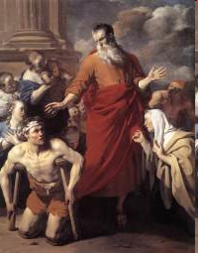
Acts 14:8-10 shows us plainly that the Galatians believed and worshipped idols.
Here’s an example:
Paul was used by Yahusha (Jesus) to heal a man born in
a crippled condition.

Slide 24
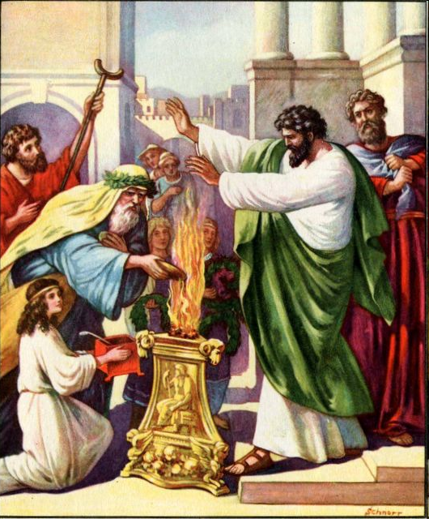
What were the results?
The pagan Gentiles wanted to worship Paul and Barnabas thinking the apostles were their gods, Jupiter and Mercury! They even wanted to offer sacrifices
to them. (vs. 11-13)

Slide 25
They wanted to do what?
These pagans wanted to offer sacrifices to them because they believed Paul and Barnabas were Jupiter and Mercury that came down from Heaven. They fully intended
to worship them!

Slide 26

Paul and Barnabas pleaded with them to
not do such a thing and were scarcely able to restrain them (vs. 14-18).
People were so convinced Paul and Barnabas were gods that it was very difficult to restrain them!

Slide 27
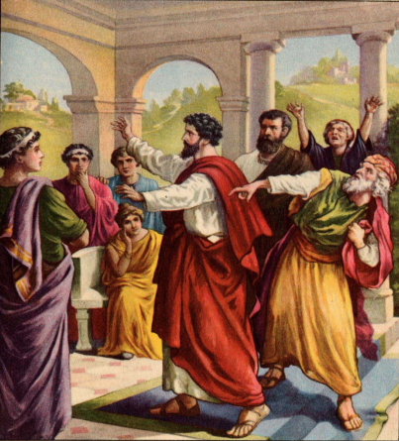
So what is the major theme of the epistle of Galatians?
Paul’s major theme in the epistle of Galatians is
to put the Galatians “back on track”
because someone had been teaching
“a different gospel,”
a perversion of the gospel of Messiah, according to Galatians 1:6-7.

Slide 28

They definitely got off track!
Actually that can happen to anyone,
if they don’t know why they believe
what they believe.
We need to build on a firm foundation otherwise we will be “tossed to and fro, and carried about with every wind of doctrine” as stated in Ephesians 4:14.

Slide 29
Paul wasted no time in expressing his disappointment with the Galatians, and how
“I am astonished that you are so quickly deserting the one who called you by the grace of Messiah and are turning to a different gospel — which is really no gospel at all” (1:6-7).
This is a rebuke where Paul is quite disturbed about the Galatians being led off course.
He expresses being upset at how “some people are throwing you into confusion and are trying to pervert the gospel of Messiah” (1:8), actually telling the Galatians that even if an angel would come with a different message than the one that he had preached to them — “let him be eternally condemned!” (1:8b) - something he makes
a point of repeating (1:9).

Slide 30

False teachers were trying to beguile the Galatians into returning to their former ways.
What were they returning to?
To their former ways! And Paul was alarmed!

Slide 31
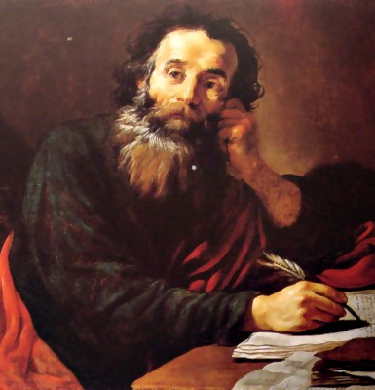
Paul’s concern for the Galatians is that they were being led astray and led right back into the life they should have left behind.

Slide 32
Many Bible interpreters conclude that Paul
was now associating Judaism with paganism, which does not make sense at all.
Paul observes how “when you did
not know Elohim, you were slaves
to those who by nature are not gods.
But now that you know YHVH — or
rather are known by YHVH —
how is it that you are returning back
to those weak and miserable principles.”
“Do you wish to be enslaved by them
all over again?” (Galatians 4:8-9)

Slide 33
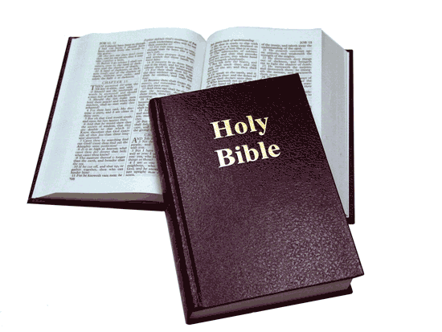
In Galatians 4:1-7 Paul compares the state of a non-Believer to being a child, (4:1), someone who is silly and foolish, who lives under bondage to sin, under the elements of the world - until the time is set by his father to formally acknowledge his son as Heir.
Paul tells the Galatians, “also, when we were children, we were in slavery under the basic principles of the world” (4:3).
But it is quite problematic to associate “the elemental things of the world,” (as many interpreters do), in comparison to Yahuwah’s commandments actually being of the same substance as paganism.

Slide 34

According to Galatians 4:6 the Messiah came in order to free them from the elements of the world,
“when the time had fully come, YHVH sent his Son, born of a woman, born under law,
to redeem those under law,
that we might receive the full rights as sons.”
Yahusha’s sacrificial work has freed Believers from
the Torah’s curse and penalties laid down upon them
for the sins they had committed (Galatians 3:13-14).

Slide 35
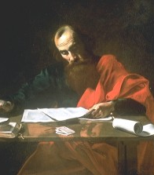
We read in Galatians 4:8: “Howbeit then, when you knew not Elohim, you did service unto them which by nature are no gods.” KJV

Slide 36
In this verse Paul brings up the subject
of the idolatry and paganism that the Galatians had participated in before their conversion.

Slide 37
Paul is making it very clear that YHVH
had called them out of
that former way of life.
Don’t go back to that way of life again!
I am very concerned about you!
Let’s go to Galatians 4:9 “But now, after that you have known Elohim, or rather
are known of Elohim, how turn you again (back) to the weak and beggarly elements, whereunto you desire again
to be in bondage?"

Slide 38

Let’s take time to ask
an important question.
Which of Yahuah’s laws
in Torah would/could
be classed as
“weak and beggarly elements”?
Does Yahuah do anything that
is “weak & beggarly”?

Slide 39
So verse 9 reveals that after their conversion to Yahusha, the Galatians did “turn again” (or backslide) to the “weak and beggarly elements.” These “beggarly elements” Paul says, is what got them into “bondage” again!
Since the Galatians were Gentiles, it makes no sense to say that they were returning to the
“law of Moses,”
which they knew nothing about nor had ever
kept before their conversion, in the first place!
So these “weak and beggarly elements”
had nothing to do with
the commandments of Elohim or the
“Law of Moses” as given by YHVH.

Slide 40
Before their conversion, on certain days, times, months and years they served the pagan gods. Paul found them doing exactly the same thing again – they had turned back
to their old ways!

Slide 41

It is very difficult to break
old habits and customs!
Can you identify with that?
Have you tried before to break old habits?
Was it easy?
Plus you have all the peer pressure from your old friends and family!

Slide 42
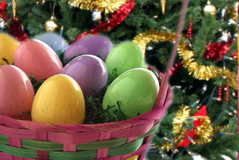
Isn‘t that the same today?
It is very difficult for many to break the custom of celebrating Easter, Christmas, Halloween, Mother‘s Day, Valentines, birthdays, etc.,
even though they originated in paganism and have
absolutely nothing to do with our Messiah Yahusha.
Because we are used to these holidays,
we’ve learned to like and love them.
There is such a good time being together with old friends and family!
It takes conviction to break such customs and risk the loss of friends at the same time.

Slide 43
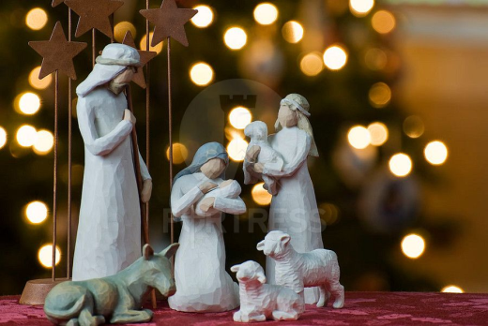
Paul calls these traditions
“weak and beggarly elements.”
It is just as true today as it was then!
It was pagan then and it is pagan now!
The “weak and beggarly elements” were demon-inspired, idolatrous practices.
Not something
YHVH Elohim
had commanded.

Slide 44
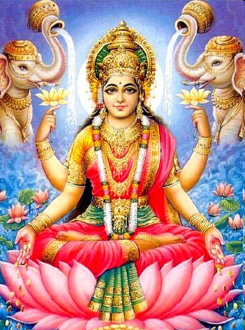
They are called
“the elements of the world.”
It does not say
“the elements of YHVH.”
We are not dealing with something from Yahuwah,
but with elements and foundations coming from Satan.

Slide 45
Paul is warning the Galatians
to NOT go back to the
“rudiments of the world” –
the man-made practices which
Paul regarded as a “yoke of bondage.”
Yahusha Himself spoke strongly against such man-made commandments,
because they negate the very Commandments of Yahuwah.

Slide 46
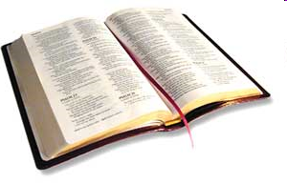
The Bible states in Mark 7:7-9 … “Howbeit in vain
do they worship me, teaching for doctrines the commandments of men. 8. For laying aside the commandment of Elohim, ye hold the tradition of men, as the washing of pots and cups:
and many other such like things ye do.
9. And He said unto them,
Full well ye reject the commandment of Elohim,
that ye may keep
your own tradition.”

Slide 47
Paul’s warning to the Galatians is definitely for mankind today.
So many are largely steeped in human traditions that are mostly borrowed
from paganism which, needless to say, are contrary or antagonistic to Yahuwah’s commandments.
Since they are contrary to His way,
these human traditions,
far from being harmless,
actually bring curses as Paul warns.
47

Slide 48
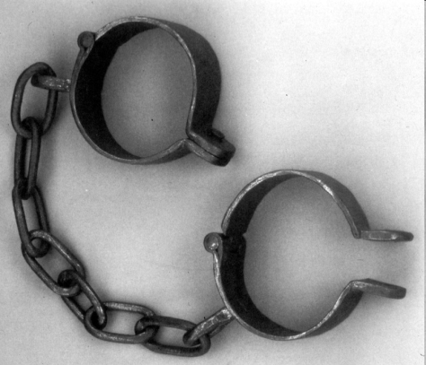
Another important fact:
verse 3 mentions being “in bondage.”
Bondage is something difficult; to be born of oppression,
of captivity,
of withholding liberty.
Bondage is grievous;
but the keeping of Yahuwah’s Law is not, as it is called
the law of liberty (James 2:12).

Slide 49

Keeping Yahuwah’s Torah Laws is freeing and liberating. They were never meant to
be a burden.

Slide 50
Love is never a burden
but always supports,
frees and liberates.
It should be very clear that the “elements of the world” and the “bondage” of Galatians 4:4 cannot refer to the Law of YHVH, nor does verse 10.

Slide 51
Let’s review a concept we’ve already mentioned.
Remember & consider this point: that it would be about as close to blasphemy as one could get if a person, in this case the apostle Paul, were to call something that Yahuwah Elohim gave and intended to be
good and liberating,
as “weak and beggarly”
and tending to “bondage”!

Slide 52

What does pagan worship look like?

Slide 53
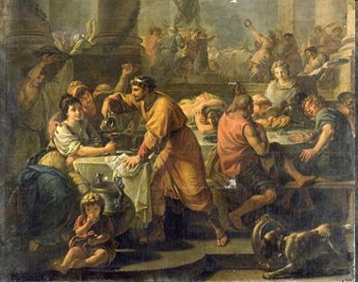
Saturnalia – (The Carnival Celebration that became Christmas & New Year's Eve)
In pagan Rome, the celebration of the Winter Solstice began on December 17
with the feast of Saturn – also called the Saturnalia. Through December 23rd the Roman world engaged in merrymaking
and the exchanging of gifts
in honor of father, son and mother. http://www.carnaval.com/saturnalia/

Slide 54
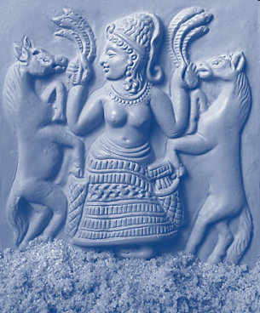
The Feast of Astarte with special cakes made to this 'queen of heaven' - today it is Easter and hot cross buns.
Astarte, or Ishtar, was the main female deity, and is known in the Bible as the 'Queen of Heaven.' In Jer. 7:16-18, Yahuwah told His prophet …
‘Pray no more for these people... My anger is great! Watch the children gather wood and the fathers build fires, and the women knead dough and make cakes to offer to the "Queen of Heaven" and to their other gods.'

Slide 55
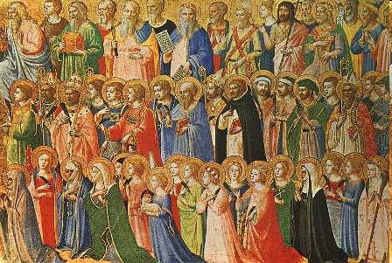
All Saints Day or Halloween!
Halloween actually began with the ancient Celtic tribes who lived in the British Isles (609-610 AD). November 1 was a day of honoring the dead and celebrating the New
Year. Christians combined the ancient practices and came up with All Saints Day, a Sacred Christian holiday meant to honor the Saints of the church who died, especially those who have been martyred for their faith. Halloween is a blend of pagan and Christian rituals … leave it alone.

Slide 56

Women weeping for Tammuz – is called Lent today.
Lent was unknown to the disciples
and it did not find its way into the
Christian Church until several centuries after the time of Christ.
The celebration of Lent has no basis in Scripture, but rather it developed from the pagan celebration of Semiramis mourning for forty days over the death of Tammuz.

Slide 57
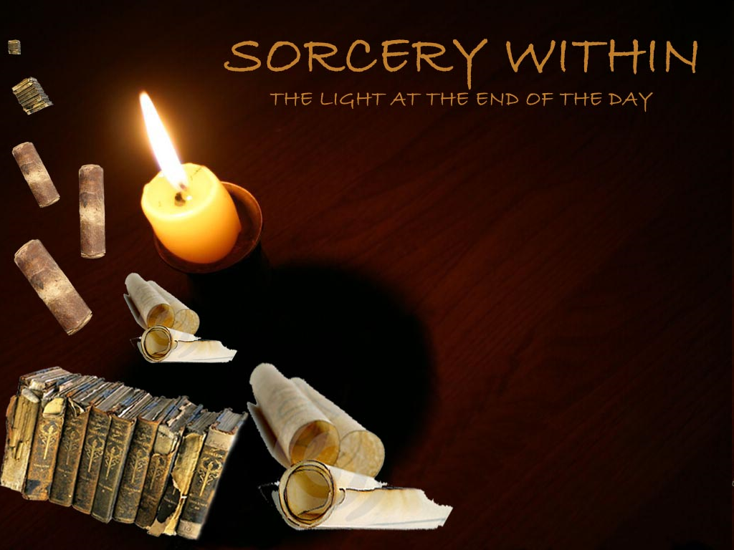
WHAT ARE TIMES?
To observe “times” was a heathen practice of divination often attached to heavenly bodies. In Greece it developed into regular seasons.
Turn to Lev. 19:26 and Deut. 18:10, 14
to read with your own eyes that YHVH orders His people NOT to observe “times”!

Slide 58
The following is a quote from
Bingham’s Antiquities of the Christian Church, pp 1123 and 1124.
“Many were superstitiously addicted
to divination…in the celebration of
these 'times' (they) set up lamps
in the market place, and crowned their doors with garlands" - as is done at Christmas time today!

Slide 59
How much more proof does a person need? The days Paul was forbidding were pagan days and NOT given by Yahuwah?
The Law of Moses absolutely forbids the observance of [pagan] ‘times.’
These superstitious ‘times’ which Paul forbids, were pagan customs.
These same pagan customs were practiced by so called 'Christians' in the days of the Catholic Bishop Chrysostom,
who lived in the fourth century.

Slide 60
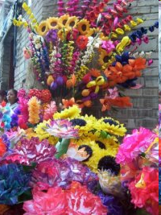
DAYS CELEBRATED
Besides 'times,' special days in honor of the dead were observed by the Greeks.
"The rites took place on the … unlucky days accompanied by complete idleness and cessation of business." (From Rest Days, p. 79.)
Several churches today celebrate pagan days in honor of the dead, such as All Soul's Day and All Saint’s Day (called Halloween by the world). Paul forbids Believers to observe these heathen days!

Slide 61
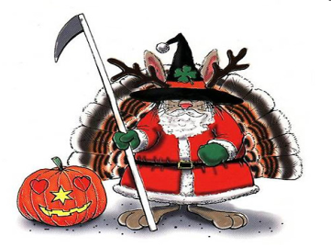
The days the Gentile Galatians were returning to,
are today the same old pagan days even now masquerading under Christian sounding names!
"Many of the holy days in the religious calendar of Christendom were borrowed, as is well known, from the festivals of ancient paganism." (Rest Days, p. 306.)
And the Elohim of Abraham, Isaac and Israel THUNDERS
at our people saying: "LEARN NOT the way of the heathen!"
Jeremiah 10:1-4

Slide 62

One wonders, how long it will take
for professed Christians to
get that message?

Slide 63
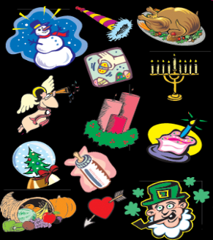
There were numerous days observed as
idolatrous festivals through old heathen idolatry.
These days, consecrated to deities of the State religious cults, were 'unlucky' because of the influence of the gods.
These civil and religious days were "regarded as unsuitable for many purposes, both public and private:
for battles, levies, sacred rites, journeys and marriages. We are told they owed their unlucky quality to the pronouncement of the Senate and pontiffs."
(From Rest Days by Webster, p. 171.)

Slide 64

Unlucky Friday
the 13th?
How many people today, even so-called Believers, continue similar beliefs? Have you never heard of unlucky Friday the thirteenth?
Paul tried to educate these Galatians to forego this foolish and superstitious regard for heathen days.
The same should be done today.
Let us educate Believers to let go of these pagan festivals.

Slide 65
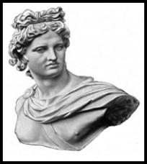
In Gal. 4:10 Paul also mentions
"months and years" - another heathen custom!
Heathen festivals were held, during the months of the year in honor of the Greek gods!
The months of April and October were dedicated to the Greek god of Apollo, the god of prophecy, music, intellectual pursuits, healing, plagues, and sometimes, the sun.

Slide 66
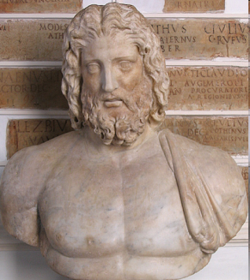
Zeus, was their highest god!
The month of February and June
were dedicated to Zeus.
He was considered to be the
god of the sky and weather.
His image appeared on most Greek coins.
For the Greeks, he was the King of the gods, who oversaw the universe.

Slide 67
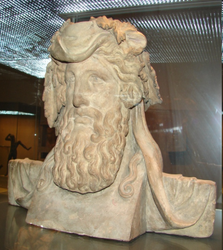
The Roman god Bacchus
The month of January was
dedicated to Bacchus.
Bacchus was the Roman name for the Greek god Dionysus, the god of wine.
Dionysus, as the god of wine, inspired madness and was a major figure of Greek mythology. He represents not only the intoxicating power of wine, but also its social and beneficial influences.
He was also known as Bacchus and the frenzy he induces, bakcheia.

Slide 68
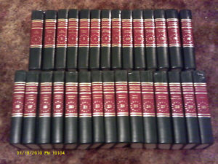
Never did Yahuwah our Creator command His people to observe months.
Check these things out for yourself in
the Encyclopedia Americana, under the article "Festival."

Slide 69
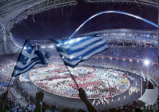
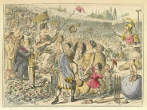
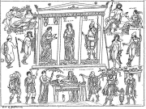
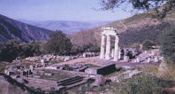
Certain years were also set aside every two or four years.
National idolatrous feasts took place during those years, like the Olympics, the Ishmiam Games, the Nemean and the Pythian Games.
Each one of these games was connected with idolatrous worship
and ceremony.

Slide 70
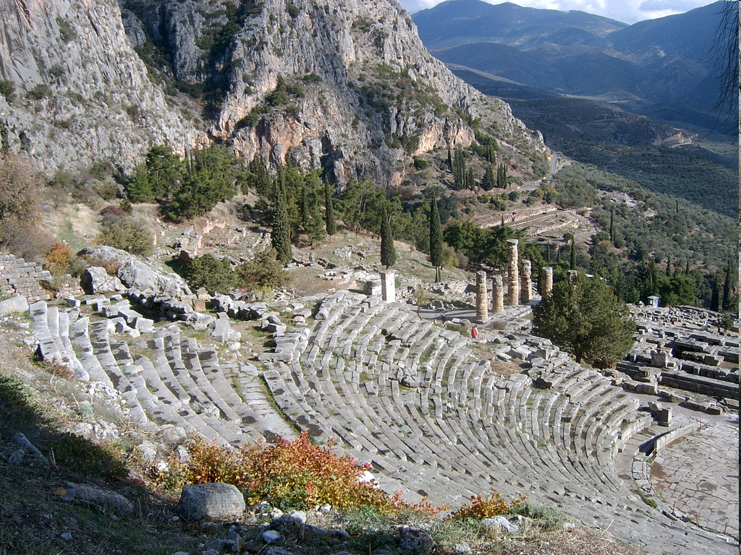
Paul and Yahusha never observed
these “times” and commanded the Church NOT to observe them!
That means His followers today shouldn’t observe or participate in
them either.
70

Slide 71

The Galatians had been converted
from heathen customs to KNOW the
true Elohim,
the Elohim
of Abraham, Isaac and
Jacob.
They kept His commandments, including HIS feast days.

Slide 72
To KNOW Him meant
they kept His Torah,
they turned from sin
and all pagan practices.
They then kept His commandments, statutes
and judgments.
Is that a reasonable assumption?

Slide 73

The Galatians were taught to walk even as Messiah walked. (I John 2:6)
So must we walk as He walked!

Slide 74

How did Yahusha walk?
Among other things, He kept the weekly Sabbath as well as the Holy days and set us an example that we should follow
His steps.

Slide 75

If Yahusha is truly living within our hearts, we will keep the same days as
He did while
on earth.
HE does not change! (Heb. 13:8)

Slide 76
Hebrews 13:8 says: “Yahusha the same yesterday, and today, and forever.”

Slide 77

Summary!
Researching the Bible and History,
it is obvious that the Gentile Galatians were being admonished
NOT to return to
the heathen practice of observing
days, months,
times, and years
they had kept before their conversion.

Slide 78
Galatians 4:10 does NOT refer
in any degree to the Holy days
of YHVH, which He gave
as statutes to be observed
by His people forever.
Paul didn't want these Galatians,
once converted and keeping Yahuwah’s commandments,
to go back to their previous idolatrous heathen practices
of keeping the pagan
"days, months, times, and years."
Would you share
Paul’s passion?

Slide 79
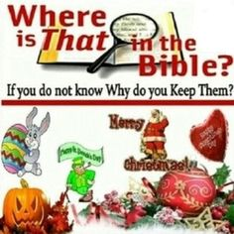
Neither should we
keep the pagan holidays like Christmas, Easter, Halloween, Lent, Valentines etc. Why not?
Because Yahuwah Elohim calls them abominations!

Slide 80
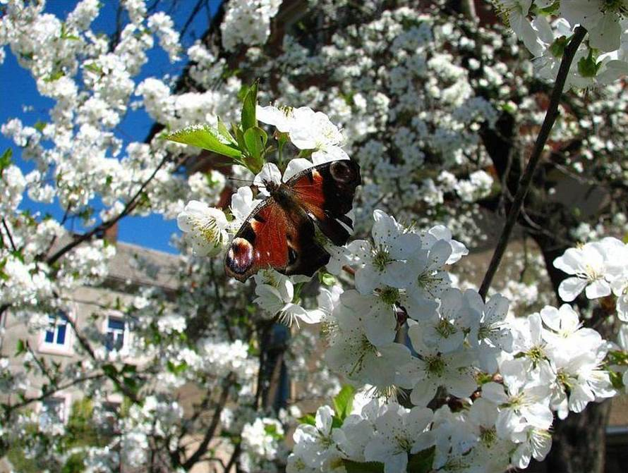
Let’s remember to honor Yahuwah's
weekly and yearly appointments.
These convocations will be a blessing
as well as a joy, a delight, holy and honorable.
Notes:
.

Slide 81
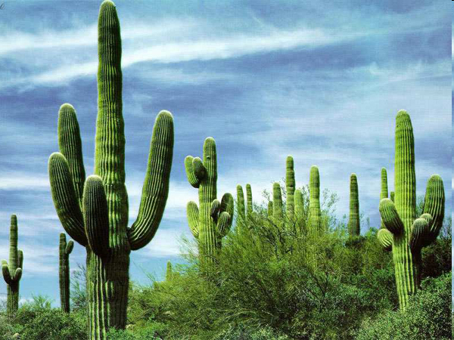
These appointments are
for our sanctification!

Slide 82

To emphasize it again ...
Neither the weekly Sabbath, the New Months nor the Yearly Feast days were ever, nor will they ever be called: “weak and beggarly elements.” Neither will they lead to “bondage.”

Slide 83
It is an offence and a slap in the face to our Creator to call HIS appointed festivals
“weak and beggarly elements that lead to bondage.”

Slide 84

The purpose of all the feast days (weekly, monthly & yearly) is
to focus on our Creator and Saviour, to spend time with Him.
From Him we receive all the earthly and spiritual gifts & blessings.
When we meet with our Creator we are being recharged anew!

Slide 85
In Matthew 11:28 He invites His people to come to Him: “Come unto me, all ye that labor and are heavy laden, and I will give you rest.” KJV

Slide 86
We could say it this way: “Come unto me, all ye that labor and are heavy laden to my appointed weekly, monthly and yearly feasts; and ye shall find rest unto your souls and be refreshed.”

Slide 87
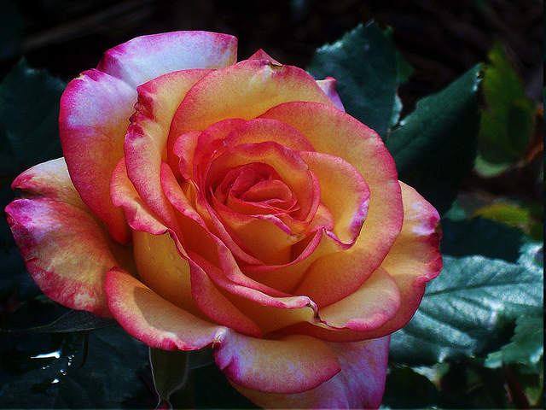
The Creator himself invites man to
His feast days.
He personally made the appointments - not the Jews,
nor the Israelites, nor any other individual!
And He expects man to come
to these appointments!
Has He a right to do so?

Slide 88
Over and over again we can read the words of the Bible saying:
These are MY feasts!

Slide 89

However, there are places listed in the Bible when …
Yahuwah calls the new Months and the yearly feast days “Your new Months,
your appointed feasts etc.”
We have some examples in Isaiah 1:13-14;
Amos 5:21; Amos 8:10; Malachi 2:3.
Is there a contradiction here?
Aren’t all of these His appointments?
Why the change from “My” to “yours”?

Slide 90
What caused the sudden change?
When Judah and Israel observed
Yahuwah’s feasts according to
their man-made timetable
AND the pagan moon calendar,
Yahuwah refers to them as “Your feasts.”
Doing this, they separated themselves from HIM!

Slide 91

When we are doing our own thing; when we follow our own timetable, and follow our own course, ….
Notes:
What happens?

Slide 92
… then it is no longer Yahuwah’s Sabbath and feasts,
but our Sabbath and our feasts!
In that case, are we still His people? (See Isaiah 58)
What brought that change about?
Notes:
We will see that in the next slide!

Slide 93
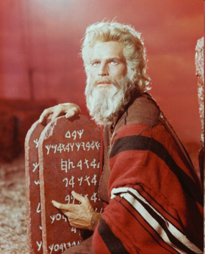
In Exodus chapter 32 Yahuwah did not acknowledge the Israelites as His people anymore by calling them Moses’ people!
It states in Exodus 32:7:
“And YHVH said unto Moses: Go, get thee down; for thy people which thou broughtest out of the
Land of Egypt, have corrupted themselves.”

Slide 94

What happened?
Because they had corrupted themselves by making a golden calf proclaiming that
“these are thy gods, O Israel, which brought thee up out of the Land of Egypt,”
even though they claimed this would honor Yahuwah by proclaiming a feast for Him.
By doing this they changed leaders, they separated from the Life giver and were no longer His people.

Slide 95
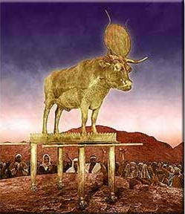
So when the Israelites made …
A golden calf, by this act they separated themselves from YHVH, even though they proclaimed the
next day a feast
to His honor.
(See Exodus 31:5.)

Slide 96
They were no longer His people with this action, because His people do not go their own ways; they don’t do their own thing and worship golden calves.
The same holds true with the
celebration of pagan holidays,
even though these pagan holidays
are given Christian names – they are still linked to paganism.
Pagan holidays are not holy because they have Christian names, neither are they acceptable to our Creator.

Slide 97

Man cannot make something holy or
keep something holy that Yahuwah,
the Creator, has not made holy!
We cannot keep pagan holidays
and expect to receive a blessing
from our Creator.
Only His appointed days
at His appointed times on HIS calendar are blessed and holy.
Why is that so difficult to understand?

Slide 98

Satan hates
Yahuwah’s Feasts!
That’s the reason he invented his own calendar
and his own holidays that honor him!
Notes:
Remember …………

Slide 99
The bottom Line is loving our Creator!
And worshipping HIM ALONE!

Slide 100
The weekly, monthly and yearly divine appointments should be considered invitations from our Creator to spend quality time with Him for the purpose
of being sanctified.
It is an invitation
to worship!

Slide 101

An invitation to worship!
What's wrong
with that?

Slide 102
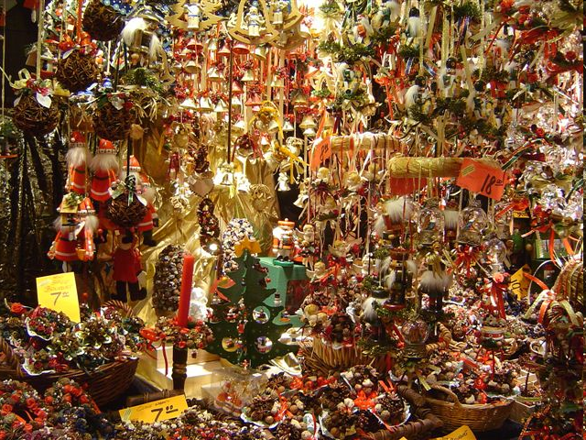
Let's stay away from following the moon,
the sun, and the pagan holidays, including
all of the “weak and beggarly elements!”

Slide 103

Let's obey and honor
the Life giver!
Keeping His appointed times, following His calendar, is my prayer for each one of us!

Slide 104




Slide 105


The supreme provider is Yahusha Ha Mashiach
Produced and Narrated by Walter Tschoepe
Malachi4.4@Reagan.com

